Slide 1

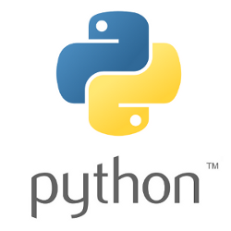

Python and the Python Environment
Framework Training

Slide 2
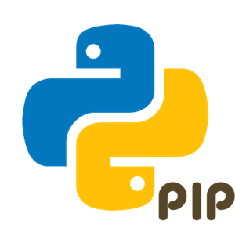
Plan for Session
Python Programming Language
Where is Python used
Common Python Libraries
Execution Model
Running Python Programs
Python Environments
Pip and virtual environments

Slide 3
Python Programming Language
Originates in 1980s created by Guido van Rossum
Several versions current is Python 3.x
A Hybrid Dynamically Typed language
Allows for Procedural Programming
Supports Object Oriented Programming
Facilities Functional Programming
Has dynamic typing, Easily extendible
Has an extensive set of built in and third-party libraries
Graphics, UIs and Graphing
CSV, Excel and databases
Machine Learning and Data Science etc.
…

Slide 4
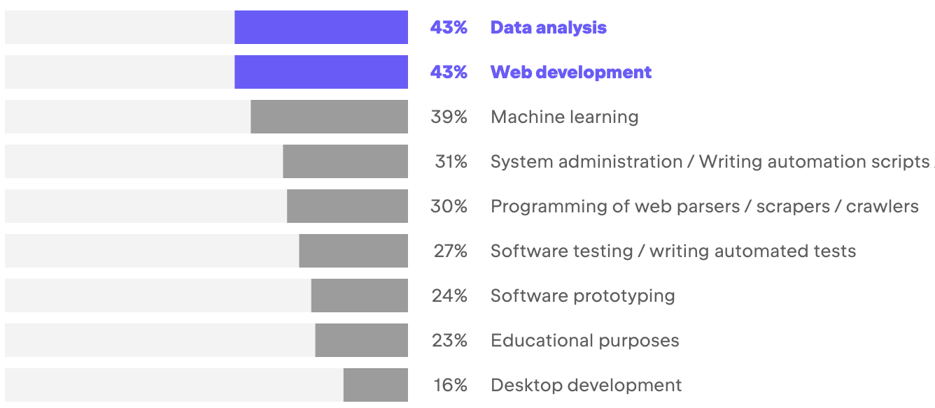
Where is Python Used?
Data Analysis & Web Development most common
Machine Learning catching up
https://www.jetbrains.com/lp/devecosystem-2022/python/

Slide 5
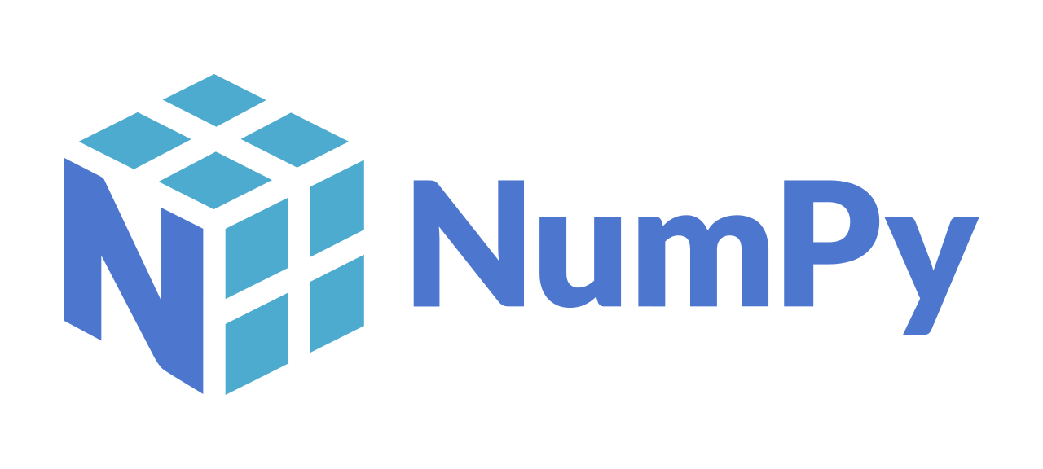

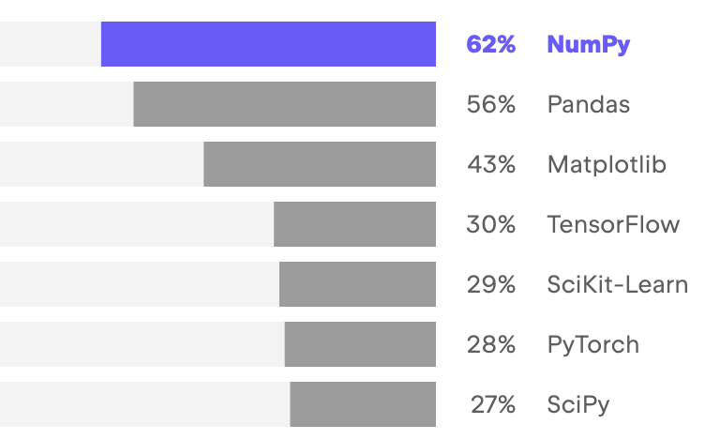
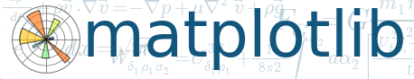

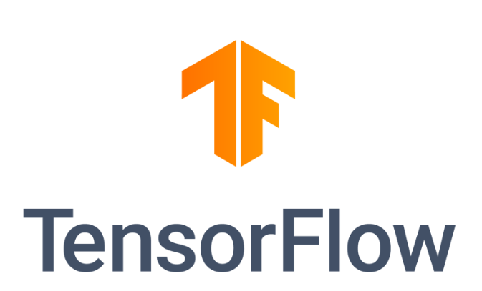
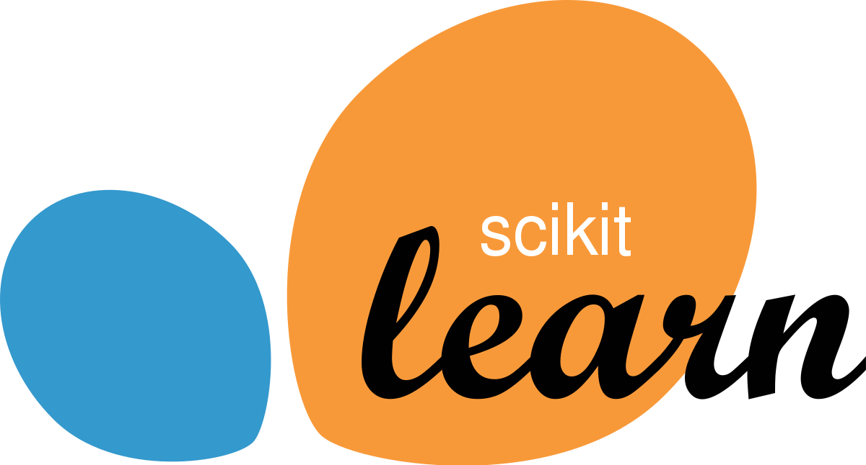
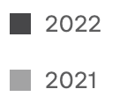
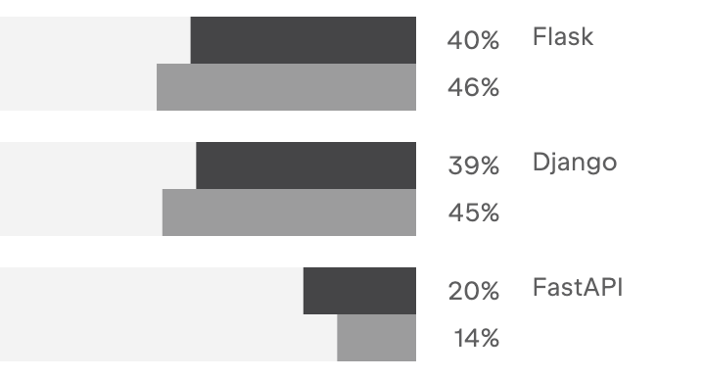
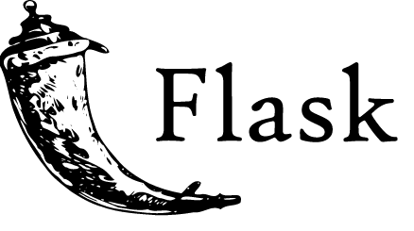

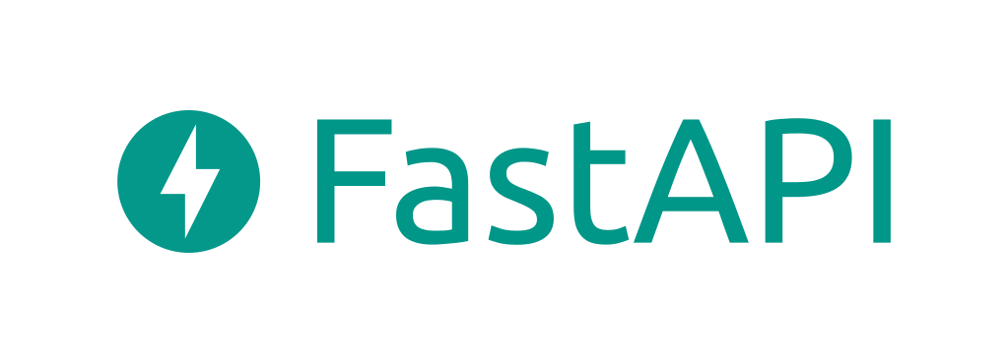
Common Python Libraries
https://www.jetbrains.com/lp/devecosystem-2022/python/
Data Science Libraries
Web Frameworks

Slide 6

Python Execution Model
Not a precompiled language
But not exactly an interpreted language either
Simplified process illustrative of behaviour
Note don’t use ‘-’ in filenames – may cause problems later
Check the Program is valid and well formed
Python
hello.py
(Dynamically) Compile
Into the Intermediate language
Run the intermediate
version of the program
Notes:
The way in which the Python interpreter processes a Python program is broken down into several steps. The steps shown here are illustrative (and simplified) but the general idea is correct.
First the program is checked to make sure that it is valid Python, that is a check is made that the program follows all the rules of the language and that each of the commands and operations etc. is understood by the Python environment.
It then translates the plain text, English like commands, into a more concise intermediate format that is easier to execute on a computer. Python can store this intermediate version in a file which is named after the original file but with a ‘.pyc’ extension instead of a ‘.py’ extension (the ‘c’ in the extension indicates it contains the compiled version of the code).
The compiled intermediate version is then executed by the interpreter.

Slide 7
Running Python Programs
Several ways to run Python programs
Interactively using the Python interpreter (REPL)
Stored in a file and run using the Python command
Run as a script file
which includes the interpreter to use as 1st line
From within an IDE environment
such as PyCharm, Eclipse, Visual Studio Code

Slide 8
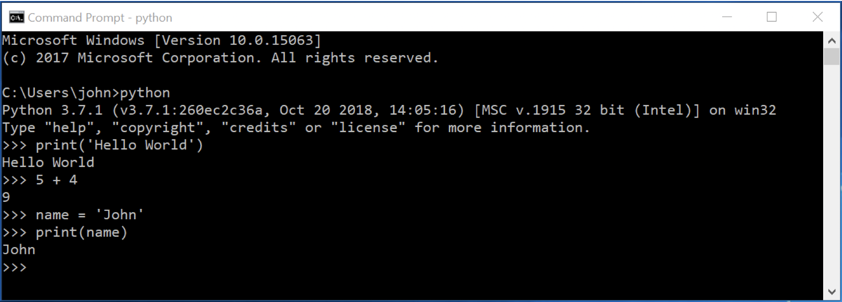
Python Interpreter
Python REPL (Read Evaluate Print Loop)
To exit REPL
On Windows press Ctrl-Z and then Enter
One Mac / Linux press Ctrl-D
Alternatively, use exit() or quit()

Slide 9
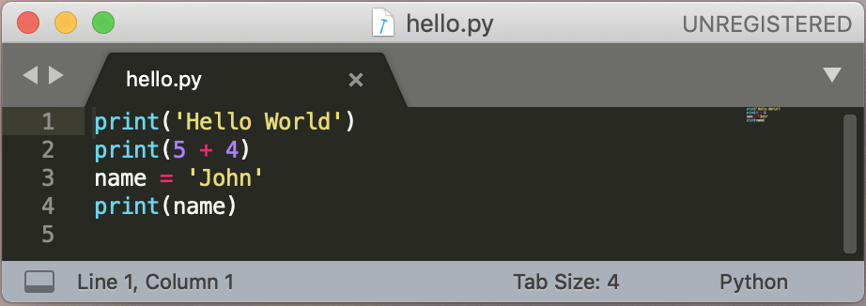
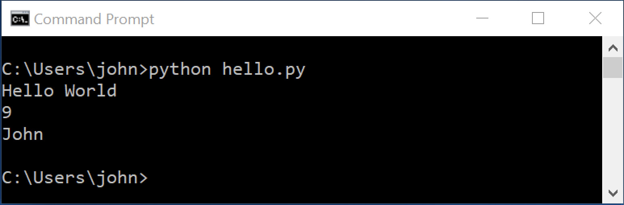
Python File
Commands stored in a file
with a .py extension
run the file using python command

Slide 10
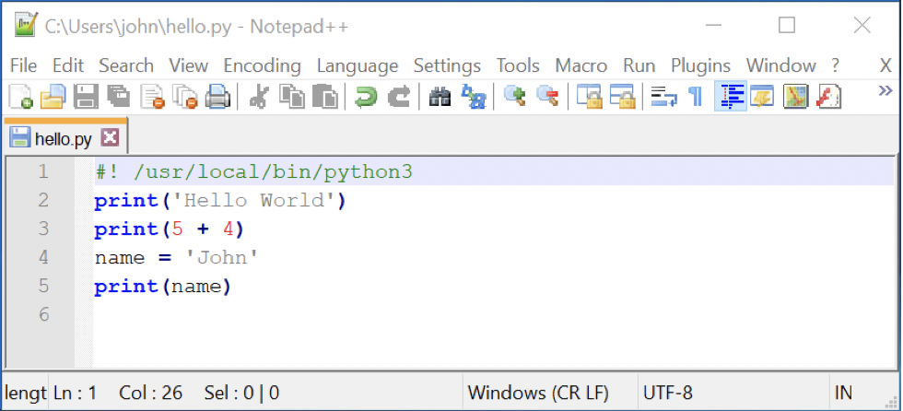
Python Script
Can run as a stand-alone file
need to add the interpreter to use as 1st line via #!
Will need to make it executable e.g. on Unix
Can run program in file directly
chmod +x hello.py
./hello.py
Notes:
By default Windows does not have the same concept. However, to prompt cross platform portability the Python Launcher for Windows can also support this style of operation. It allows scripts to indicate a preference for a specific Python version using the same #! (Shebang) format as Unix style operating systems. We can now indicate that the rest of the file should be interpreted as a Python script; if multiple versions of Python are installed this may require Python 3 to be explicitly specified. The launcher also understands how to translate the Unix version into Windows versions so that /usr/local/bin/python3 will be interpreted as indicating that python3 is required.

Slide 11
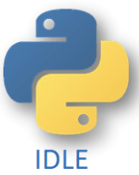
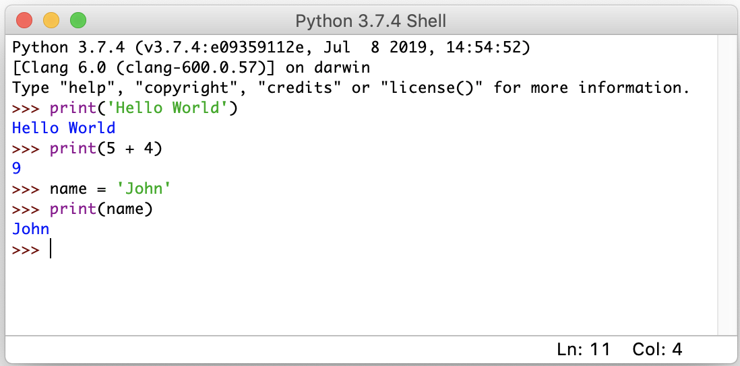
Python IDLE
Pythons own Integrated Development and Learning Environment (IDLE)
Light weight environment in which to use the REPL
(Read Evaluate Print Loop)
Or create programs using edit mode

Slide 12

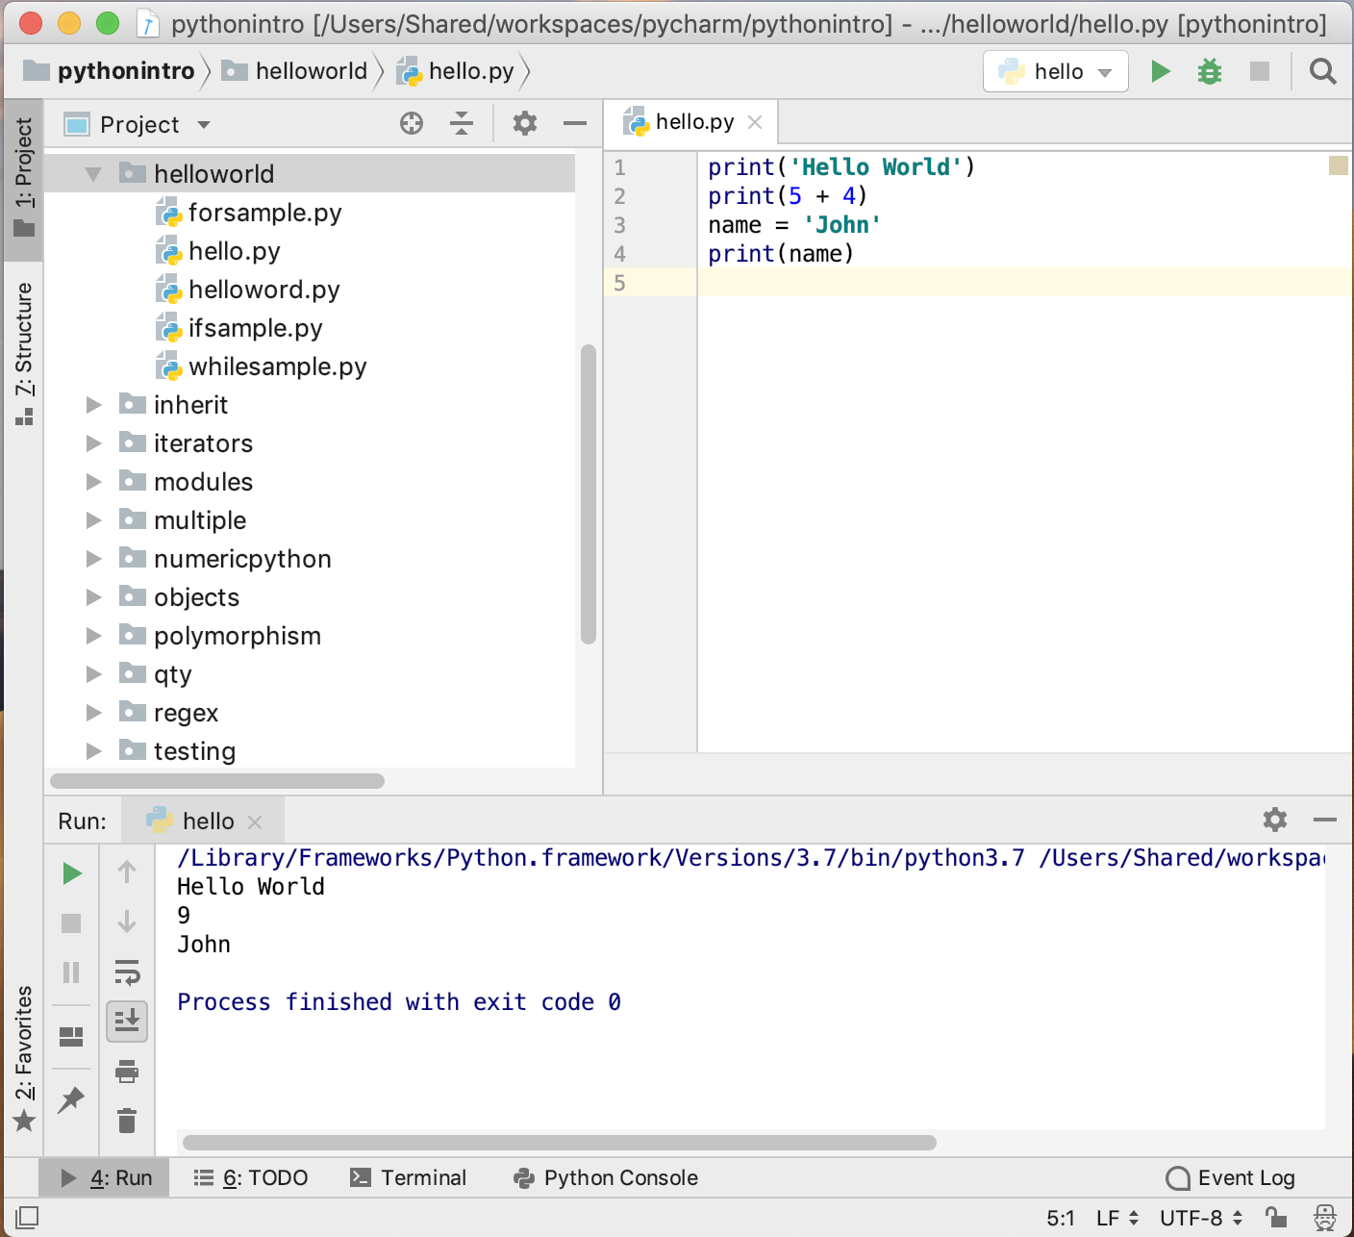
Python IDEs
Several Python IDEs available
PyCharm
both free version
and commercial
Visual Studio Code
Free IDE from Microsoft
Spyder
scientific dev apps
Eclipse + PyDev plugin
Jupyter Notebooks
target data analysis tasks

Slide 13
Jupyter Notebooks
Targets data analysis tasks
Can write lines of code and easily execute whole program or individual lines of code
then when you make a change can rerun
Built on top of IPython REPL
Jupyter Notebook provides web based front end
Notebook launched from command line using
opens a browser window
jupyter notebook
Notes:
IPython – Interactive Python originally for Python but now multi-language
can install jupyter with Anaconda (it comes bundled)
Or if already have Python installed can use pip
First, ensure that you have the latest pip; older versions may have trouble with some dependencies:
pip3 install --upgrade pip
Then install the Jupyter Notebook using:
pip3 install jupyter

Slide 14
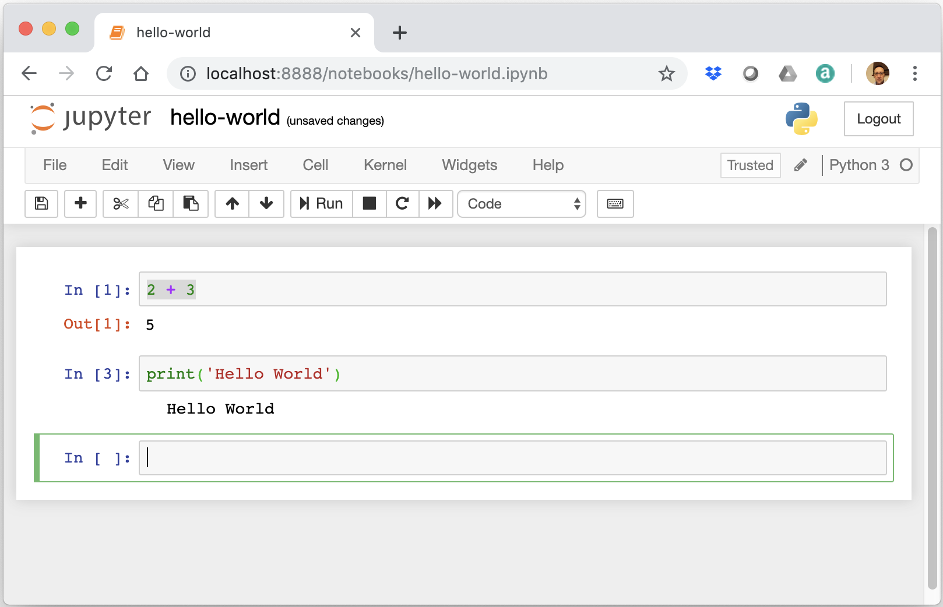
Jupyter Notebooks
Notes:
Select menu option New Python3 notebook
Starts up a notebook server in the back ground

Slide 15
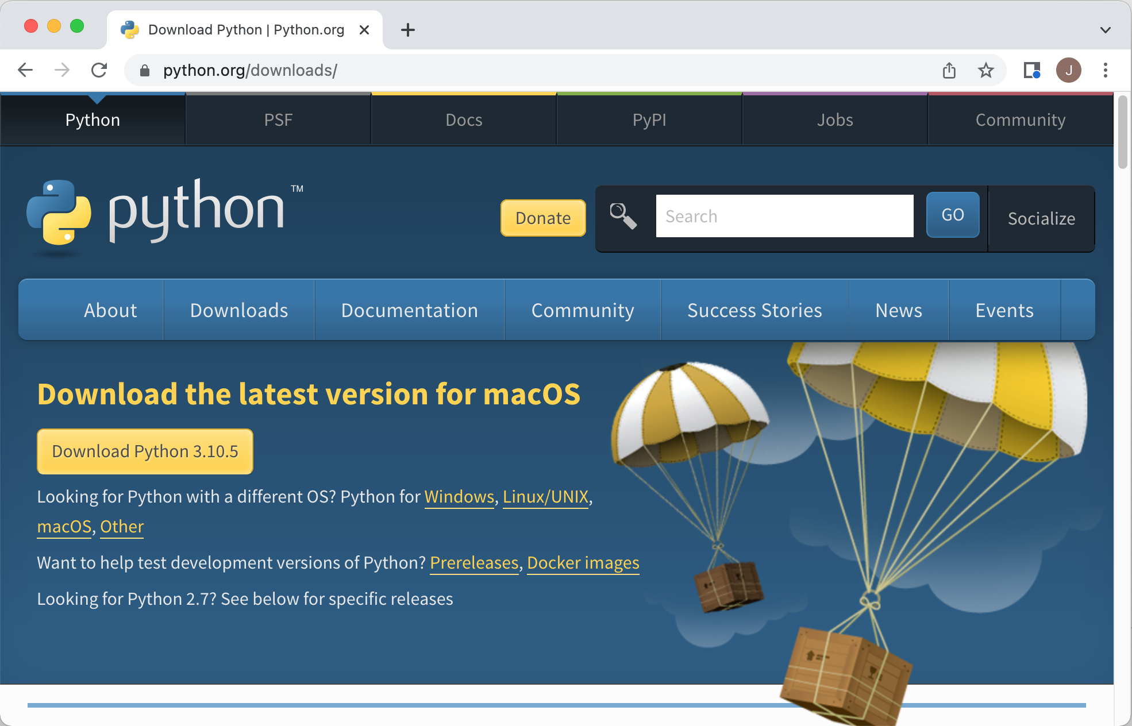
Where to get Python
https://www.python.org/downloads/

Slide 16
Python Environments
Typically use a tool to handle Python environments
Required as may have different projects
that use different versions of Python 3.7, 3.8, 3.9, 3.10 etc.
that use different libraries NumPy, SciPy, Pandas, Matplotlib
and different versions of those libraries
Problem for Python
installs libraries for a Python runtime
by default globally on a machine
Two commonly used environment tools
pip virtual environments / conda environments
we will look at virtual environments and pip

Slide 17
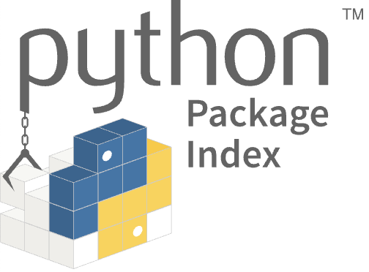
Pip and Virtual Environments
Can use virtual environments venv module
see https://docs.python.org/3/library/venv.html
tool to create isolated Python package configurations
included as part of Python 3 and pip
use source to activate on Mac (or activate.bat on Windows)
Each virtual environment can have its own set up
Installs <whatever> in virtual env venv3 in current directory
from Python Package Index https://pypi.org/
Typically used through IDE
$ python -m venv <envname>
$ source <envname>/bin/activate
(venv3)
$ pip install <whatever>

Slide 18
Working with Pip
Open a Command (Windows) or Terminal (Mac)
check installation
install package
create a virtual environment
to use or activate / deactivate the environment
update the pip installation
to see whats been installed
pip --version
pip install pandas
pip install pandas==1.5.2
python -m venv venvProj1
source venvProj1/bin/activate
deactivate
pip install --upgrade pip
pip freeze

Slide 19
Working with Pip
% mkdir cernlabs
% cd cernlabs
% python -m venv venv3
% source venv3/bin/activate
(venv3) % pip --version
pip 22.3.1 from ../cernlabs/venv3/lib/python3.11/site-packages/pip (python 3.11)
(venv3) % pip install pandas
Collecting pandas
Using cached pandas-1.5.3-cp311-cp311-macosx_10_9_x86_64.whl (11.9 MB)
Collecting python-dateutil>=2.8.1
Using cached python_dateutil-2.8.2-py2.py3-none-any.whl (247 kB)
Collecting pytz>=2020.1
Using cached pytz-2022.7.1-py2.py3-none-any.whl (499 kB)
Collecting numpy>=1.21.0
Using cached numpy-1.24.2-cp311-cp311-macosx_10_9_x86_64.whl (19.8 MB)
Collecting six>=1.5
Using cached six-1.16.0-py2.py3-none-any.whl (11 kB)
Installing collected packages: pytz, six, numpy, python-dateutil, pandas
Successfully installed numpy-1.24.2 pandas-1.5.3 python-dateutil-2.8.2 pytz-2022.7.1 six-1.16.0
(venv3) % deactivate
%

Slide 20
Useful Resources
Python Software Foundation
https://en.wikipedia.org/wiki/Python_Software_Foundation
The main Python 3 documentation site
https://docs.python.org/3/
List of all the builtin features
https://docs.python.org/3/library/index.html
Python 3 Module of the week site
https://pymotw.com/3
Python Resources
https://wiki.python.org/moin/BeginnersGuide/Programmers
W3 School Intro to Python
https://www.w3schools.com/python/

Slide 21
Questions?
?

